Slide 1

Geometry Class Library
Descriptions of the “PathGeom” class of functions

Slide 2

Many applications require a reference path
For example, roads are a form of path. The task of driving is to stay on the road, which means that a vehicle’s position relative to the path must be measured.

Slide 3
Definitions of terms are important so that we don’t get confused later
Station
Stations
Path
Paths
Traversal
Traversals

Slide 4
For many examples below, MATLAB code will be given. It is usually highlighted as shown here: yellow for scripts, grey for console outputs.
%% Example 1: simple three points
fig_num = 1;
x = [-4; -2; 1];
y = [0; -4; -1];
apex_points = [x y];
fcn_FastestTraversal_calculateObstacleDirectionAtApexPoints(...
apex_points, fig_num);
>> script_test_fcn_geometry_selfCrossProduct
cross_products =
0
err =
1

Slide 5
Each function uses a secondary argument check function
function fcn_geometry_checkInputsToFunctions(...
variable,variable_type_string,varargin)
% fcn_geometry_checkInputsToFunctions
% Checks the variable types commonly used in the geometry codes to
% ensure they are correctly formed.
%
% This function is typically called at the top of most functions. The input
% is a variable and a string defining the "type" of the variable. This
% function checks to see that they are compatible. For example, say there
% 'column_vector' type of variables used in the function that is always a N
% x 1 array; if someone had a variable called "test_example", they could
% check that this fit the 'column_vector' type by calling
% fcn_geometry_checkInputsToFunctions(test_example,'column_vector').
% This function would then check that the array was N x 1, and if it was
% not, it would send out an error warning.
See: script_test_fcn_geometry_checkInputsToFunctions.m for example usages

Slide 6
Distance calculations can be done in 2d or 3d between sets of points using: fcn_geometry_euclideanPointsToPointsDistance

Slide 7
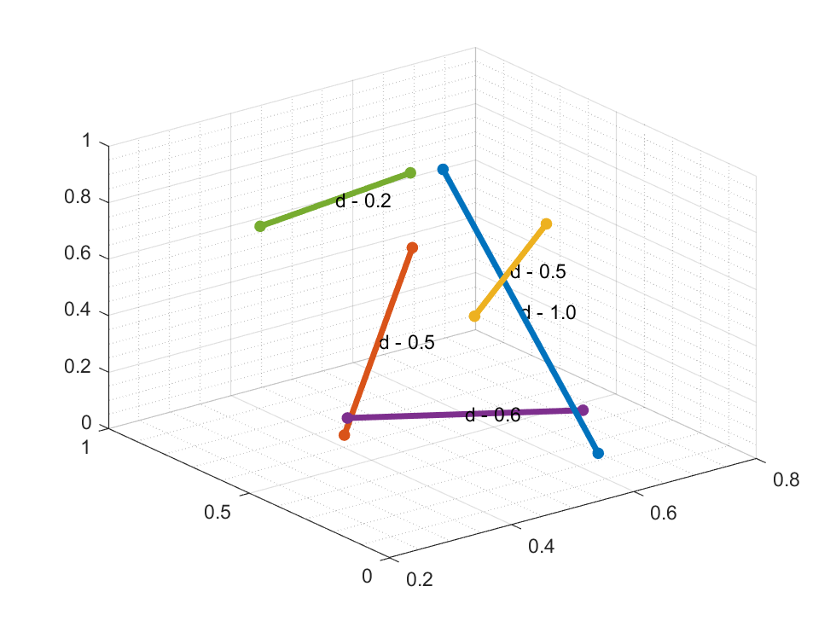
To fit a line, one can use the point-slope fitting function: fcn_geometry_fitSlopeInterceptNPoints
NOTE: it works in 2D or 3D
%% BASIC example - multiple points in 3D
fig_num = 34;
pt1 = rand(5,3);
pt2 = rand(5,3);
dist=fcn_geometry_euclideanPointsToPointsDistance(pt1,pt2,fig_num);
See script_test_fcn_geometry_euclideanPointsToPointsDistance

Slide 8
For vertical line fitting, the slope becomes undefined, so it is better to fit point clusters via polar regression methods. The function that does this is: fcn_geometry_fitVectorToNPoints
fig_num = 42;
Npoints = 1000;
x_data = 2*ones(Npoints,1)+ 0.2*randn(Npoints,1);
y_data = linspace(-1,10,Npoints)';
points = [x_data,y_data];
[root_point, unit_vector] = fcn_geometry_fitVectorToNPoints(points,fig_num);

Slide 9
Finding the intersection of segments

Slide 10
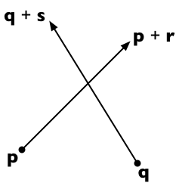
The most basic path operation is finding the intersection of a path segment rooted at p and extending to p+r, with a sensor rooted at q and extending to p+s.
Details can be found at: https://stackoverflow.com/questions/563198/how-do-you-detect-where-two-line-segments-intersect

Slide 11
This capability is implemented in fcn_Path_findProjectionHitOntoPath.m
% fcn_Path_findProjectionHitOntoPath calculates hits between a sensor
% projection and a path, returning the distance and location of the hit.
%
% FORMAT:
%
% [distance,location] = ...
% fcn_Path_findProjectionHitOntoPath(path,...
% sensor_vector_start,sensor_vector_end,...
% (flag_search_type),(fig_num))
%
% INPUTS:
%
% path: an N x 2 vector containing the X,Y points of the path to be
% checked for intersections
%
% sensor_vector_start: a 1 x 2 vector containing the X,Y points of the
% sensor's start location
%
% sensor_vector_end: a 1 x 2 vector containing the X,Y points of the
% sensor's end location
%
% (OPTIONAL INPUTS)
% flag_search_type: an integer specifying the type of search.
%
% 0: return distance and location only if the given
% sensor_vector overlaps the path (this is the default)
%
% 1: return distane and location if any projection of the sensor
% vector, in any direction, hits the path (in other words, if
% there is any intersection). Note that distance returned will
% be negative if the nearest intersection is in the opposite
% direction of the given sensor vector.
%
% fig_num: a figure number to plot results. Turns debugging on.
%
% OUTPUTS:
%
% distance: a 1 x 1 scalar representing the distance to the closest
% intersection of the sensor with the path
%
% location: a 1 x 2 vector of the X,Y location of intersection point

Slide 12
This method requires the definition of the cross product
Define the 2-dimensional vector cross product v × w to be v_{x} w_{y} − v_{y} w_{x}.
%% Calculate cross products
function result = crossProduct(v,w)
result = v(:,1).*w(:,2)-v(:,2).*w(:,1);
end

Slide 13
The method used is to consider fractions of the path and of the sensor vectors
Suppose the path segment runs from p to p + r and sensor starts from q and extends to q + s. Then any point on the first line is representable as p + t r (for a scalar parameter t) and any point on the second line as q + u s (for a scalar parameter u).

Slide 14
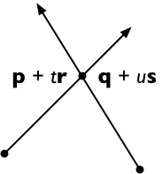
The two lines intersect if we can find t and u such that:
p + t r = q + u s
To solve, cross both sides with s, getting
(p + t r) × s = (q + u s) × s
And since s × s = 0, this means
t (r × s) = (q − p) × s
And therefore, solving for t:
t = (q − p) × s / (r × s)

Slide 15
We can solve for u similarly:
(p + t r) × r = (q + u s) × r
u (s × r) = (p − q) × r
u = (p − q) × r / (s × r)
To reduce the number of computation steps, it's convenient to rewrite this as follows (remembering that s × r = − r × s):
u = (q − p) × r / (r × s)

Slide 16
If the lines are parallel then r × s = 0
If (q − p) × r = 0, then the lines are co-linear as well. NOTE: this is NOT checked for in the code!
In this case, express the endpoints of the second segment (q and q + s) in terms of the equation of the first line segment (p + t r):
t₀ = (q − p) · r / (r · r)
t₁ = (q + s − p) · r / (r · r) = t₀ + s · r / (r · r)
If the interval between t₀ and t₁ intersects the interval [0, 1] then the line segments are collinear and overlapping; otherwise they are collinear and disjoint.
Note that if s and r point in opposite directions, then s · r < 0 and so the interval to be checked is [t₁, t₀] rather than [t₀, t₁].

Slide 17
If parallel and non-intersecting?
If r × s = 0 and (q − p) × r ≠ 0, then the two lines are parallel and non-intersecting

Slide 18
What if they intersect?
If r × s ≠ 0 and 0 ≤ t ≤ 1 and 0 ≤ u ≤ 1, the two line segments meet at the point p + t r = q + u s. Otherwise, the two line segments are not parallel but do not intersect.
Credit: this method is the 2-dimensional specialization of the 3D line intersection algorithm from the article "Intersection of two lines in three-space" by Ronald Goldman, published in Graphics Gems, page 304. In three dimensions, the usual case is that the lines are skew (neither parallel nor intersecting) in which case the method gives the points of closest approach of the two lines.

Slide 19
Intersections at the end-points of the path
If intersections occur at the end-points of a path segment, then results can be ambiguous because t = 0 or t=1. In these cases, can have weird situations if we omit this, e.g. the following:
((0<t).*(1>t).*(0<u).*(1>u));
The result of this condition is that NO intersection would be detected

Slide 20
If we correct the t-range, then the intersection is found
good_vector = ((0<=t).*(1>=t).*(0<u).*(1>u));

Slide 21
Similarly, this form with the u range not including 0 or 1 can miss paths that barely hit the sensor at start or end
Missing the origin is a particularly bad error as it would cause one to miss overlapping paths

Slide 22
Here’s the correct result
good_vector = ((0<=t).*(1>=t).*(0<=u).*(1>=u));

Slide 23
Example 1: A simple example
See: script_test_fcn_Path_findProjectionHitOntoPath.m
%% Simple test 1 - a simple intersection
fprintf(1,'Simple intersection result: \n');
path = [0 10; 10 10];
sensor_vector = [2 1; 5 15];
fig_debugging = 2343;
[distance,location] = ...
fcn_Path_findProjectionHitOntoPath(path,sensor_vector,fig_debugging);
print_results(distance,location);

Slide 24
Example 2: Not intersecting
See: script_test_fcn_Path_findProjectionHitOntoPath.m
%% Simple test 2 - no intersections
fprintf(1,'No intersection result: \n');
path = [-4 10; 2 10];
sensor_vector = [0 0; 5 12];
fig_debugging = 2343;
[distance,location] = ...
fcn_Path_findProjectionHitOntoPath(path,sensor_vector,fig_debugging);
print_results(distance,location);

Slide 25
Example 3: Multiple line segments
See: script_test_fcn_Path_findProjectionHitOntoPath.m
%% Simple test 3 - multiple intersections
fprintf(1,'Multiple intersections result: \n');
path = [0 10; 10 10; 0 6; 10 6; 0 2];
sensor_vector = [0 0; 5 12];
fig_debugging = 2343;
[distance,location] = fcn_Path_findProjectionHitOntoPath(...
path,sensor_vector,fig_debugging);
print_results(distance,location);

Slide 26
In some applications, the “length” of the sensor vector is irrelevant. One simply wants to know any location, in any direction, where an intersection could occur.
The flag_search_type variable can be set to 1 (instead of 0, default) to specify that any intersection will work. Here’s an example with a sensor vector of length 2. If an “unlimited” search is used, a hit is detected with either positive or negative distance.
flag_search_type = 0
flag_search_type = 1

Slide 27
In map calculations, we need to know whether points are in front of, or behind, a given line segment. The function that does this is: fcn_geometry_flagPointsCloserToOriginThanLineSegment
%% Test 2: a basic test
fig_num = 2;
segment_points = [1 5; 4 0];
test_points = 5*rand(10,2);
[point_flags] = fcn_geometry_flagPointsCloserToOriginThanLineSegment(segment_points, test_points,fig_num);
fprintf(1,'Point flags are:\n');
fprintf(1,'\t%.2f\n',point_flags);
See script_test_fcn_geometry_flagPointsCloserThanLineSegment for more examples

Slide 28
In case we need to calculate the polar form of a line, a function to do this is: fcn_geometry_polarLineFrom2PolarCoords
%% script_test_fcn_geometry_polarLineFrom2PolarCoords
fig_num = 1;
start_point_cart = [1 1];
end_point_cart = [4 3];
[theta1,r1] = cart2pol(start_point_cart(:,1),start_point_cart(:,2));
[theta2,r2] = cart2pol(end_point_cart(:,1),end_point_cart(:,2));
points = [theta1,r1;theta2,r2];
% Calculate the line
[phi,rho] = fcn_geometry_polarLineFrom2PolarCoords(points,fig_num);
axis([0 5 0 5]);

Slide 29
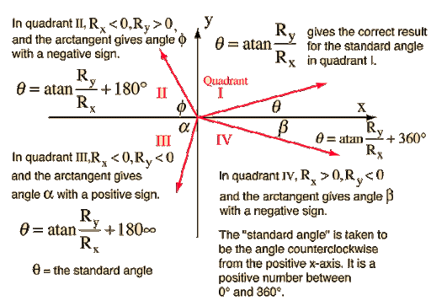
Generally, the functions used for path planning avoid calculation of angles using inverse tangents. Instead, we use dot and cross products
The main problem with using absolute angles instead of relative angles is that there will be discontinuities in angles between quadrants

Slide 30
The self cross-product operation is available to determine which direction a path is bending, to the right or to the left
%% BASIC example - find the cross-products for positive bend
fig_num = 1;
path = [0 0; 1 1; 0 2];
[cross_products] = ...
fcn_geometry_selfCrossProduct(...
path, fig_num) %#ok<*NOPTS,*NASGU>
%% BASIC example - find all the cross-products for negative bend
fig_num = 2;
path = [0 0; 1 1; 2 0];
[cross_products] = ...
fcn_geometry_selfCrossProduct(...
path, fig_num) %#ok<*NASGU>

Slide 31
It requires that paths have bends at each apex, e.g. that the lines are not straight or go straight backward at any point
%% BASIC example -
% find all the cross-products for many bends
fig_num = 3;
path = [0 0; 1 1; 0 2; 2 4; 4 2; 6 2; 2 7];
[cross_products] = ...
fcn_geometry_selfCrossProduct(...
path, fig_num)

Slide 32
If they are straight or backward, an error is returned as 1 in the argument
%% ERROR example - find cross product for bent back on self
fig_num = 5;
path = [0 0; 1 1; 0 0];
[cross_products,err] = ...
fcn_geometry_selfCrossProduct(...
path, fig_num) %#ok<*NASGU>
cross_products =
0
err =
1

Slide 33
The script to plot circles is: fcn_geometry_plotCircle
%% BASIC example for one circle
fig_num = 1;
figure(fig_num); axis square; grid minor;
center = [1,3];
radius = [2];
fcn_geometry_plotCircle(center,radii,fig_num);
%% BASIC example for multiple circles
fig_num = 2;
figure(fig_num); axis square; grid minor;
centers = [1 3; 2 4];
radii = [2; 3];
fcn_geometry_plotCircle(centers,radii,fig_num);

Slide 34
Derivation notes for fcn_geometry_circleCenterFrom3Points
By S. Brennan, sbrennan@psu.edu , 2020_05_22

Slide 35
Our goal is to find the circle that fits within three given points
Given: (x1, y1), (x2,y2), (x3,y3)
Find: (xc,yc) – the center of a circle passing through all 3 points, and r, the radius of that circle (not required, but helpful).

Slide 36
The solution approach is based on the equation for a circle
Since
$$(x−x_{c})^{2}+(y−y_{c})^{2}=r^{2}$$
So:
$$x^{2}−2⋅x⋅x_{c}+x_{c}^{2}+y^{2}−2⋅y⋅y_{c}+y_{c}^{2}+=r^{2}$$
Which, if x and y are known, is 1 equation with 3 unknowns (xc, yc, r)

Slide 37
We rearrange this to try to get a linear form
$$x^{2}−2⋅x⋅x_{c}+x_{c}^{2}+y^{2}−2⋅y⋅y_{c}+y_{c}^{2}+=r^{2}$$
Becomes:
$$x_{c}^{2}+y_{c}^{2}−r^{2}=2⋅x⋅x_{c}+2⋅y⋅y_{c}−(x^{2}+y^{2})$$
For the first point:
$$x_{c}^{2}+y_{c}^{2}−r^{2}=2⋅x_{1}⋅x_{c}+2⋅y_{1}⋅y_{c}−(x_{1}^{2}+y_{1}^{2})$$
Let $r_{01}^{2}$ be the radial distance from the origen to point 1. Then:
$$x_{c}^{2}+y_{c}^{2}−r^{2}=2⋅x_{1}⋅x_{c}+2⋅y_{1}⋅y_{c}−r_{01}^{2}$$

Slide 38
So for points 2 and 3:
$$2⋅x_{2}⋅x_{c}+2⋅y_{2}⋅y_{c}−r_{02}^{2}=2⋅x_{1}⋅x_{c}+2⋅y_{1}⋅y_{c}−r_{01}^{2}$$
Or:
$$2⋅{(x}_{2}−x_{1})⋅x_{c}+2⋅(y_{2}−y_{1}) =r_{02}^{2}−r_{01}^{2}$$
And similarly:
$$2⋅{(x}_{3}−x_{2})⋅x_{c}+2⋅(y_{3}−y_{2}) =r_{03}^{2}−r_{01}^{2}$$

Slide 39
This admits a matrix form:
$$2⋅{(x}_{2}−x_{1})⋅x_{c}+2⋅(y_{2}−y_{1}) =r_{02}^{2}−r_{01}^{2}$$
$$2⋅{(x}_{3}−x_{2})⋅x_{c}+2⋅(y_{3}−y_{2}) =r_{03}^{2}−r_{01}^{2}$$
Becomes:
$$\left[\begin{matrix}{(x}_{2}−x_{1}) & (y_{2}−y_{1}) \\ {(x}_{3}−x_{2}) & (y_{3}−y_{2})\end{matrix}\right]\left[\begin{matrix}x_{c} \\ y_{c}\end{matrix}\right]=\frac{1}{2}\left[\begin{matrix}r_{02}^{2}−r_{01}^{2} \\ r_{03}^{2}−r_{01}^{2}\end{matrix}\right]$$
Which has the form of a regression equation:
$$A\left[\begin{matrix}x_{c} \\ y_{c}\end{matrix}\right]=b⇒\left[\begin{matrix}x_{c} \\ y_{c}\end{matrix}\right]=A^{−1}⋅b$$

Slide 40
The solution to this is solved via the MATLAB code:
num_solutions = length(points(:,1))-2; % This is the number of solutions to expect
r_squared = sum(points.^2,2); % These are the radii-squared of points from origin
diff_points = diff(points);
diff_x = diff_points(:,1);
diff_y = diff_points(:,2);
diff_rsquared = diff(r_squared);
Set up vectors:
Solve the problem:
if 1 == num_solutions % Expecting just one solution. No need for big A, b matrices
% solve for the center point
A = [diff_x diff_y];
b = 1/2*diff_rsquared;
else % Simultaneous solutions to be calculated - create big A and b matrices
% Construct the A-matrix and b matrix that will create the regressor.
% Start by filling A and b matrices up with zeros (see notes for
% explanation of iputs)
A = zeros(2*num_solutions,2*num_solutions);
b = zeros(2*num_solutions,1);
% Fill in the non-zero portions of the matrix, which will be 1 per each
% of the N solutions
for i_solution = 1:num_solutions
A(1+2*(i_solution-1):2+2*(i_solution-1),1+2*(i_solution-1)) = ...
diff_x(i_solution:i_solution+1);
A(1+2*(i_solution-1):2+2*(i_solution-1),2+2*(i_solution-1)) = ...
diff_y(i_solution:i_solution+1);
b(1+2*(i_solution-1):2+2*(i_solution-1),1) = ...
1/2*diff_rsquared(i_solution:i_solution+1);
end
end
% Solve the center points
centers = A\b;
centers = reshape(centers,2,length(centers(:,1))/2);
centers = centers'; % Make it into a column vector
% NOTE: the following line is the slowest in the code. It can be sped
% up if we do not take the square root
radii = sum((points(1:num_solutions,:)-centers).^2,2).^0.5;

Slide 41
If there are more than one circle to be solved, we can write the A matrix in block form as:
$$A=\left[\begin{matrix}\begin{aligned}x_{2−1 }y_{2−1} \\ x_{3−2 }y_{3−2}\end{aligned} & 0_{2×2} & 0_{2×2} \\ 0_{2×2} & \begin{aligned}x_{3−2 }y_{3−2} \\ x_{4−3 }y_{4−3}\end{aligned} & 0_{2×2} \\ 0_{2×2} & 0_{2×2} & \begin{aligned}x_{4−3 }y_{4−3} \\ x_{5−4 }y_{5−4}\end{aligned}\end{matrix}\right]$$
And the b-matrix is changed accordingly. Again, this has the form of a regression equation.

Slide 42
Here are some sample results
%% ADVANCED example that lets user select N points
fig_num = 1000;
figure(fig_num); clf; grid on; axis equal;
points = ginput; % Get arbitrary N points until user hits return
[centers,radii] = fcn_geometry_circleCenterFrom3Points(points,fig_num);
Type: “help fcn_geometry_circleCenterFrom3Points” for more examples, or see:
script_test_fcn_geometry_circleCenterFrom3Points.m

Slide 43

The distances traveled on an arc depend on the angle of the arc covered during motion, so many times these angles must be calculated and functions exist for this.

Slide 44
One way of finding the angles of an arc is to be given 3 points: a start, an end, and the “apex” point which is between. The function that does this is: fcn_geometry_findAngleUsing3PointsOnCircle
The apex point disambiguates the direction
%% BASIC example for one circle, incoming and outgoing are 90 degrees
fig_num = 1;
apex_points = [1 0];
centers = [0 0];
radii = [1]; %#ok<*NBRAK>
start_angles = [45]*pi/180;
start_points_on_circle = [radii.*cos(start_angles) radii.*sin(start_angles)];
end_angles = [-45]*pi/180;
end_points_on_circle = [radii.*cos(end_angles) radii.*sin(end_angles)];
incoming_source_points = [0 2^0.5];
outgoing_destination_points = [0 -2^0.5];
[angles, better_angles] = fcn_geometry_findAngleUsing3PointsOnCircle(...
apex_points,...
centers,...
start_points_on_circle,...
end_points_on_circle,...
radii,...
incoming_source_points,...
outgoing_destination_points,fig_num) %#ok<*ASGLU,*NOPTS>

Slide 45
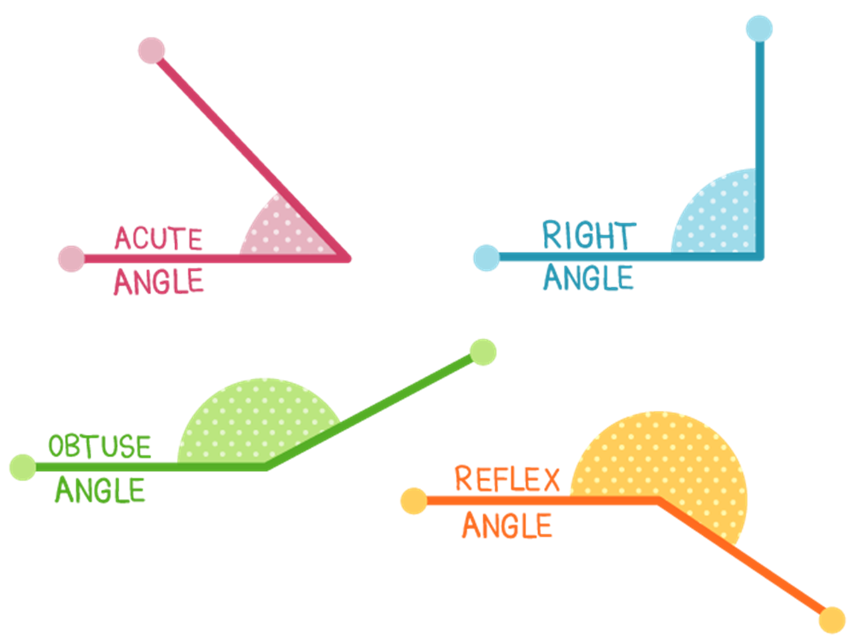
This function calculates in the following steps
Step 0: calculates the unit vectors for incoming and outgoing vectors
Step 1: takes the dot product to see if they are facing same way
Step 2: check for weird situations: parallel in same direction, opposite but entering same point, spin in different directions around circle, etc.
Step 3: use cross product to determine the “reflex angle” for situations larger than 180 degrees.
Step 4: confirm that apex angle is within same sector

Slide 46
Another means of finding angles in the arc is to specify 2 points AND the cross-product direction from start to finish. The function that does this is: fcn_geometry_findAngleUsing2PointsOnCircle
Counterclockwise is positive, clockwise is negative
%% BASIC example for one circle, incoming and outgoing are 90 degrees
fig_num = 1;
centers = [0 0];
radii = [1];
start_angles = [45]*pi/180;
start_points_on_circle = [radii.*cos(start_angles) radii.*sin(start_angles)];
end_angles = [-45]*pi/180;
end_points_on_circle = [radii.*cos(end_angles) radii.*sin(end_angles)];
cross_products = [1];
true_angle = start_angles - end_angles;
[angles] = fcn_geometry_findAngleUsing2PointsOnCircle(...
centers,...
radii,...
start_points_on_circle,...
end_points_on_circle,...
cross_products,...
fig_num);
fcn_summarize(angles,...
true_angle,...
centers,...
radii,...
start_points_on_circle,...
end_points_on_circle,...
cross_products);

Slide 47
Note: these functions support vectorization
%% ADVANCED example - vectorized
fig_num = 100;
centers = [0 0; 4 4; 8 10; -6 10];
radii = [1; 2; 4; 3];
start_angles = [90; 0; -90; 45]*pi/180;
start_points_on_circle = [radii.*cos(start_angles) radii.*sin(start_angles)]+centers;
end_angles = [45; 135; 180; 0]*pi/180;
end_points_on_circle = [radii.*cos(end_angles) radii.*sin(end_angles)]+centers;
cross_products = [-1; 1; -1; 1];
true_angle = start_angles - end_angles;
[angles] = fcn_geometry_findAngleUsing2PointsOnCircle(...
centers,...
radii,...
start_points_on_circle,...
end_points_on_circle,...
cross_products,...
fig_num);
fcn_summarize(angles,...
true_angle,...
centers,...
radii,...
start_points_on_circle,...
end_points_on_circle,...
cross_products);

Slide 48
When calculating tangents of circles, only certain circle locations are possible.
In this example, the angles between the green circle’s phi angle and red circles are all allowable tangents to the vertex created by the green and red line segments
Allowable phi range

Slide 49
The function that calculates the range of possible phi points is: fcn_geometry_findPhiConstraints
%% Simple test - should result in 90 to 45
fig_num = 9;
p_apex = [0 0];
vertex_1 = [1 0];
vertex_2 = [-1 1];
[phi_start,change] = fcn_geometry_findPhiConstraints(p_apex,vertex_1,vertex_2,fig_num);
fprintf(1,'Results of phi constrainter: \n');
fprintf('\t %.2f \t %.2f\n', ...
mod(phi_start,2*pi)*180/pi, ...
mod(change,2*pi)*180/pi);

Slide 50
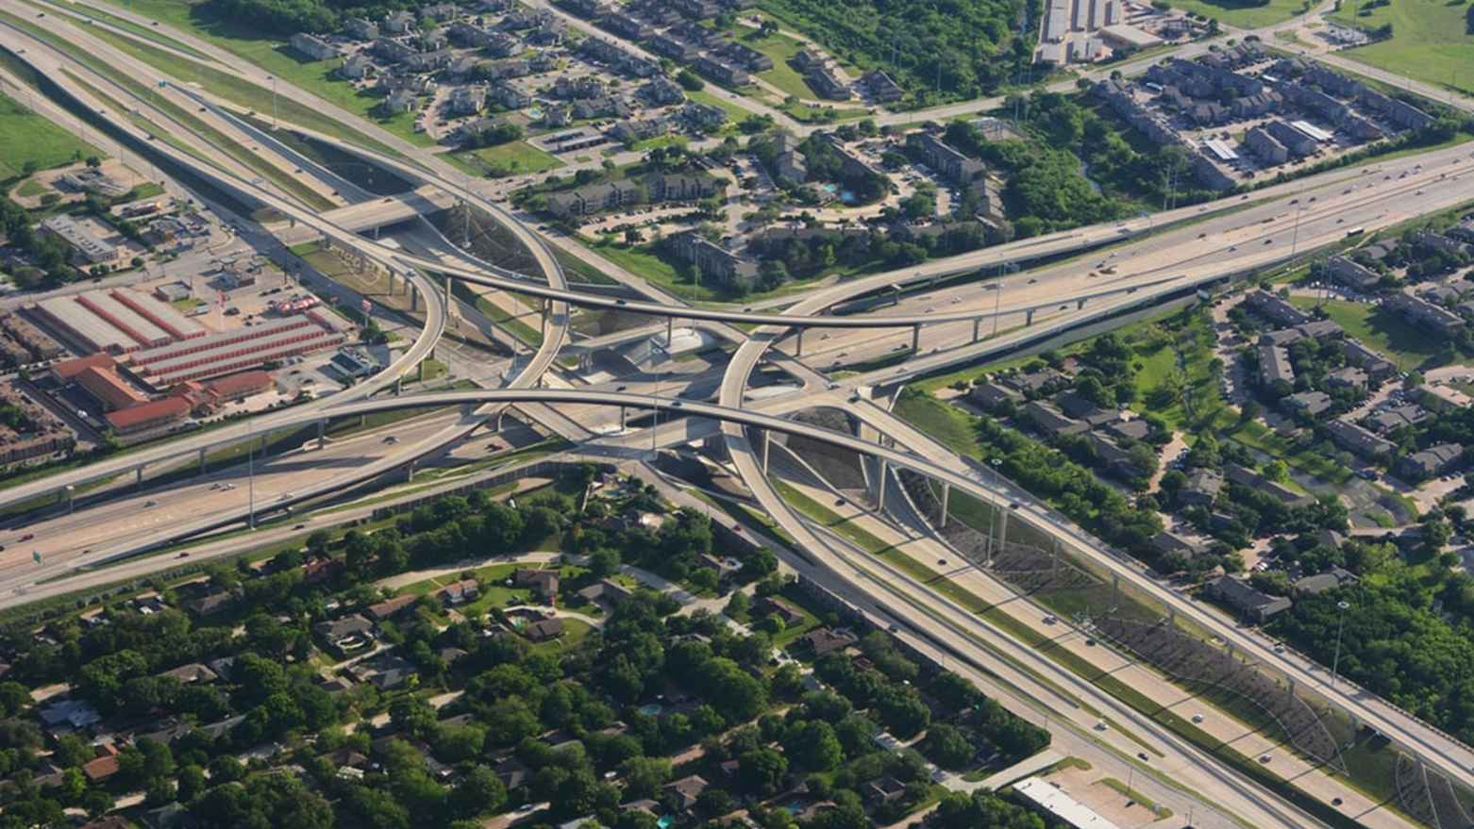
For many paths, entry into a curve at speed requires calculations of tangents into circles

Slide 51
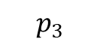
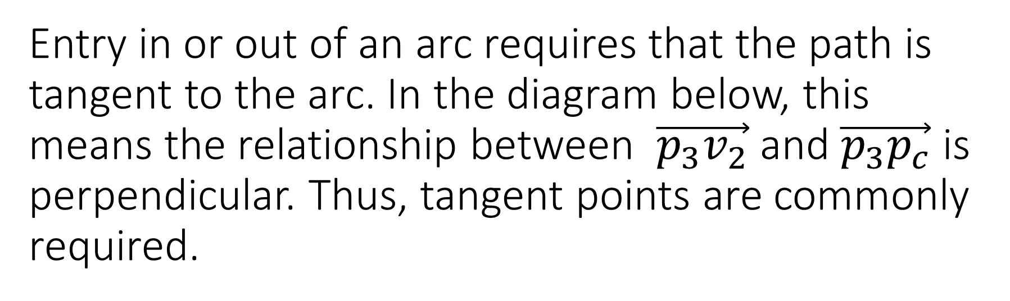
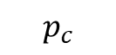
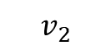
Entry in or out of an arc requires that the path is tangent to the arc. In the diagram below, this means the relationship between $\vec{p_{3}v_{2}}$ and $\vec{p_{3}p_{c}}$ is perpendicular. Thus, tangent points are commonly required.
$$p_{3}$$
$$p_{c}$$
$$v_{2}$$

Slide 52
The tangents from a circle to a point (2 for each point) can be calculated from: fcn_geometry_findTangentPointsFromPointToCircle
%% ADVANCED example that uses vectors of centers and points
fig_num = 2;
centers = [0 0; 1 4];
radii = [1; 1];
points = [2 3; 3 4];
points_tangent = fcn_geometry_findTangentPointsFromPointToCircle(...
centers,radii,points,fig_num);

Slide 53
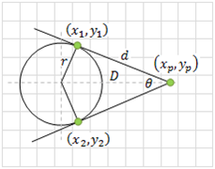
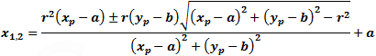
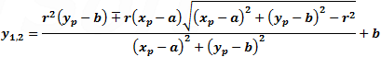
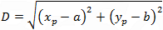
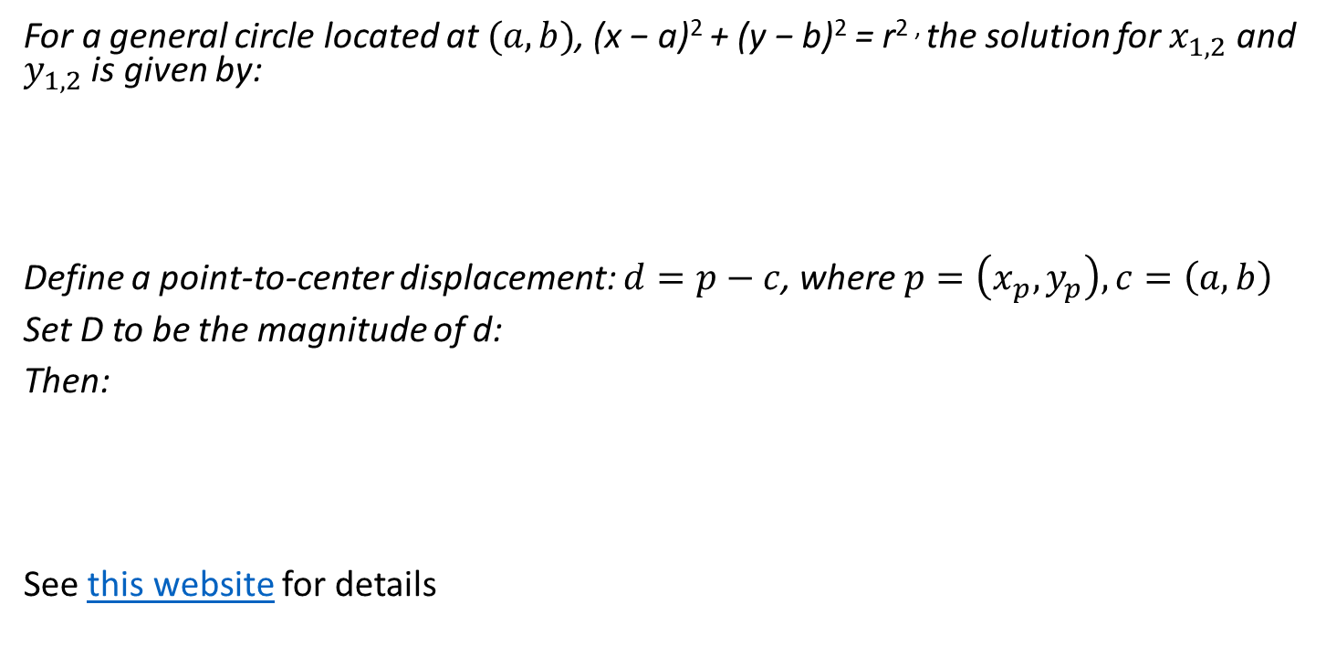
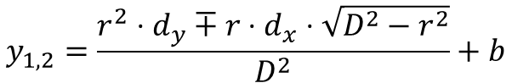
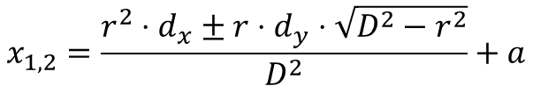
This function calculates the tangent points on a circle from a point
For a general circle located at $(a,b)$, (x − a)² + (y − b)² = r^{2 ,} the solution for $x_{1,2}$ and $y_{1,2}$ is given by:
Define a point-to-center displacement: $d=p−c$, where $p=\left(x_{p},y_{p}\right), c=\left(a,b\right)$
Set D to be the magnitude of d:
Then:
See this website for details
$$x_{1,2}=\frac{r^{2}⋅d_{x}±r⋅d_{y}⋅\sqrt{D^{2}−r^{2}}}{D^{2}}+a$$
$$y_{1,2}=\frac{r^{2}⋅d_{y}∓r⋅d_{x}⋅\sqrt{D^{2}−r^{2}}}{D^{2}}+b$$

Slide 54
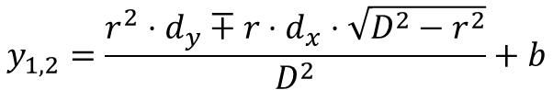
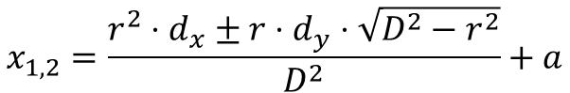
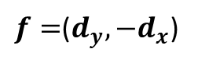
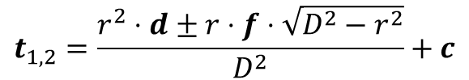
These calculations can be vectorized
From:
Then the tangent points are:
Where:
And d and c are defined as before, but vectorized into matrices of [x, y], where x and y are columns.
$$x_{1,2}=\frac{r^{2}⋅d_{x}±r⋅d_{y}⋅\sqrt{D^{2}−r^{2}}}{D^{2}}+a$$
$$y_{1,2}=\frac{r^{2}⋅d_{y}∓r⋅d_{x}⋅\sqrt{D^{2}−r^{2}}}{D^{2}}+b$$
$$t_{1,2}=\frac{r^{2}⋅d±r⋅f⋅\sqrt{D^{2}−r^{2}}}{D^{2}}+c$$
$f=$($d_{y},−d_{x}$)

Slide 55
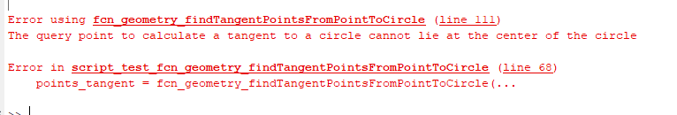
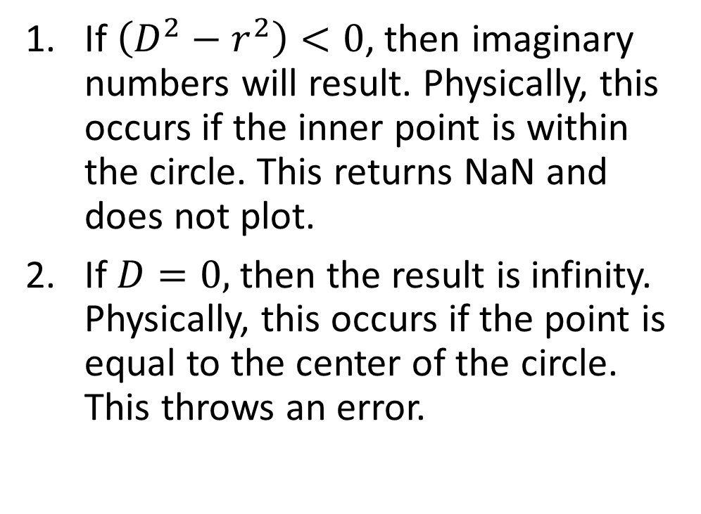
There are two conditions that cause this algorithm for inner tangents to fail
If $\left(D^{2}−r^{2}\right)<0$, then imaginary numbers will result. Physically, this occurs if the inner point is within the circle. This returns NaN and does not plot.
If $D=0,$ then the result is infinity. Physically, this occurs if the point is equal to the center of the circle. This throws an error.
%% ADVANCED example that has one point too close to the center
fig_num = 2;
centers = [0 0; 1 4];
radii = [1; 1];
points = [0.5 0.5; 3 4];
points_tangent = fcn_geometry_findTangentPointsFromPointToCircle(...
centers,radii,points,fig_num);
%% ADVANCED example that has one point on the center
fig_num = 2;
centers = [0 0; 1 4];
radii = [1; 1];
points = [1 1; 1 4];
points_tangent = fcn_geometry_findTangentPointsFromPointToCircle(...
centers,radii,points,fig_num);

Slide 56
If a single point is needed, then the cross-product can be used with fcn_geometry_findTangentPointFromPointToCircle
The function will return only the ONE tangent point where the vector from the external point to the circle tangent, crossed toward the center of the circle, has the same cross-product sign as given by the inputs.
%% BASIC example for one circle and one point (positive cross product)
fig_num = 1;
centers = [0 0];
radii = 1;
points = [2 3];
cross_prod = 1; % Keep the postive cross product
points_tangent = fcn_geometry_findTangentPointFromPointToCircle(...
centers,radii,points,cross_prod,fig_num); %#ok<*NASGU>

Slide 57
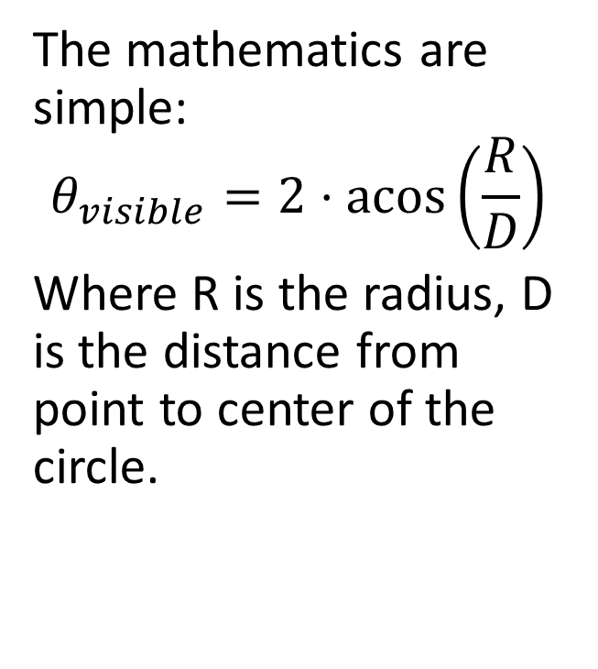
A common calculation is the amount of arc visible on a circle, from a point outside the circle
The mathematics are simple:
$$θ_{visible}=2⋅\operatorname{acos}\left(\frac{R}{D}\right)$$
Where R is the radius, D is the distance from point to center of the circle.

Slide 58
This is solved in the following function: fcn_geometry_findVisibleArcsFromPoints.m
%% BASIC example for one circle and one point
fig_num = 1;
centers = [0 0];
radii = 1;
points = [2 3];
visible_arc_angles = fcn_geometry_findVisibleArcsFromPoints(...
centers,radii,points,fig_num);

Slide 59
This function is vectorized
%% ADVANCED example that uses vectors of centers and points
fig_num = 2;
centers = [0 0; 1 4];
radii = [1; 1];
points = [2 3; 3 4];
visible_arc_angles = fcn_geometry_findVisibleArcsFromPoints(...
centers,radii,points,fig_num);

Slide 60
If a point is inside the circle, NaN is returned
%% ADVANCED example that has one point too close to the center
fig_num = 3;
centers = [0 0; 1 4];
radii = [1; 1];
points = [0.5 0.5; 3 4];
visible_arc_angles = fcn_geometry_findVisibleArcsFromPoints(...
centers,radii,points,fig_num);

Slide 61
If a query point is in the middle of the circle, this results in division by zero and gives an error
%% ADVANCED example that has one point on the center
fig_num = 2;
centers = [0 0; 1 4];
radii = [1; 1];
points = [1 1; 1 4];
visible_arc_angles = fcn_geometry_findVisibleArcsFromPoints(...
centers,radii,points,fig_num);
Error using fcn_geometry_findVisibleArcsFromPoints (line 102)
The query point to calculate a tangent to a circle cannot lie at the center of the same circle
Error in script_test_fcn_geometry_findVisibleArcsFromPoints (line 90)
visible_arc_angles = fcn_geometry_findVisibleArcsFromPoints(...

Slide 62
The tangent point or points functions are also used in the calculation of tangents to circles
fcn_geometry_findTangentPointTwoCircles – calculates only the tangent points that meet the cross-product criteria. This one is more efficient and should be used if possible.
fcn_geometry_findTangentPointsTwoCircles – calculates all the tangent points but allows options to force inner or outer tangents, as well as voting points, to produce results similar to the above. Voting does not always work, so cross product specification (via other function) is preferred.

Slide 63
The cross-product inputs are used to define which tangent to use
Positive-to-negative cross product from start-to-end Negative-to-positive cross-product
%% BASIC example - find the points for two circle, all inner
fig_num = 1;
centers_start = [1 1];
centers_end = [3 1];
radii_start = [0.5];
radii_end = [0.3];
cross_products_start = [1];
cross_products_end = [-1];
[...
points_tangent_start, ...
points_tangent_end] ...
= ...
fcn_geometry_findTangentPointTwoCircles(...
centers_start,...
centers_end,...
radii_start,...
radii_end,...
cross_products_start,...
cross_products_end,...
fig_num);
%% BASIC example - find the points for two circle, all inner, opposite cross
fig_num = 2;
centers_start = [1 1];
centers_end = [3 1];
radii_start = [0.5];
radii_end = [0.3];
cross_products_start = [-1];
cross_products_end = [1];
[...
points_tangent_start, ...
points_tangent_end] ...
= ...
fcn_geometry_findTangentPointTwoCircles(...
centers_start,...
centers_end,...
radii_start,...
radii_end,...
cross_products_start,...
cross_products_end,...
fig_num);

Slide 64
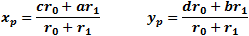
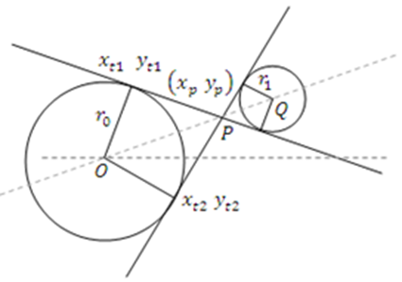
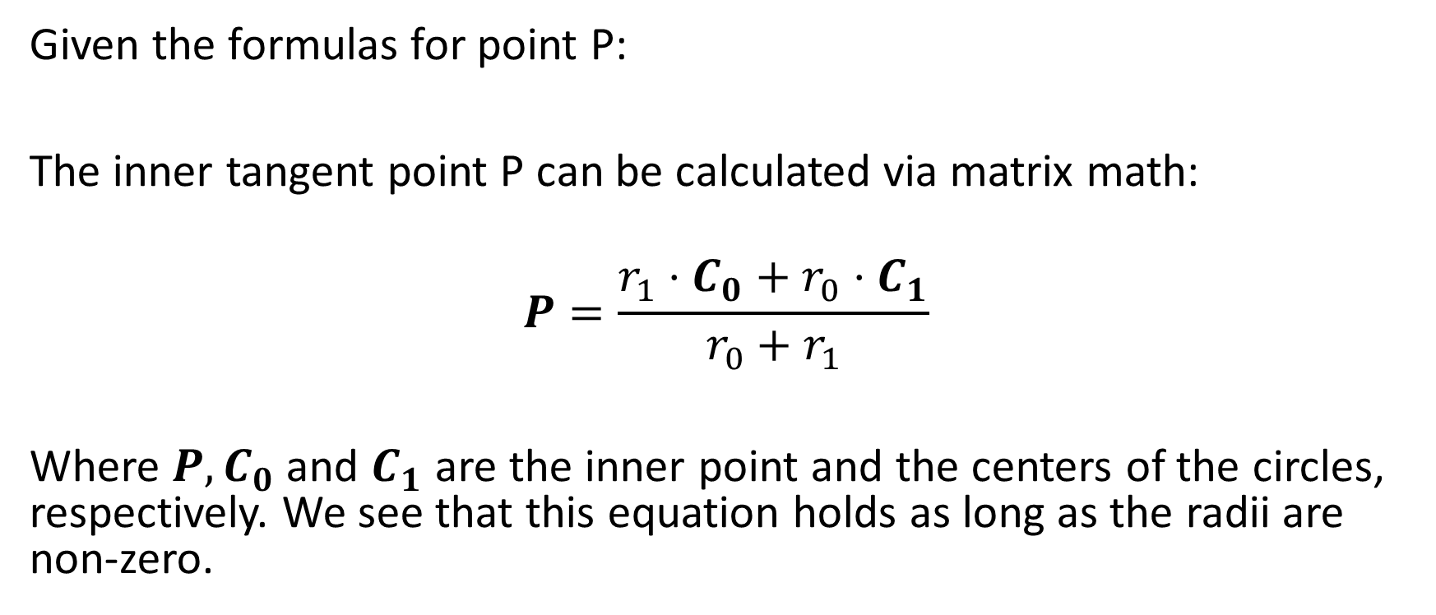
The inner tangents are determined by finding the inner point where inner tangents cross, then using the tangent point operation thereafter.
Given the formulas for point P:
The inner tangent point P can be calculated via matrix math:
$$P=\frac{r_{1}⋅C_{0}+r_{0}⋅C_{1}}{r_{0}+r_{1}}$$
Where $P, C_{0}$ and $C_{1}$ are the inner point and the centers of the circles, respectively. We see that this equation holds as long as the radii are non-zero.
See: http://www.ambrsoft.com/TrigoCalc/Circles2/Circles2Tangent_.htm

Slide 65
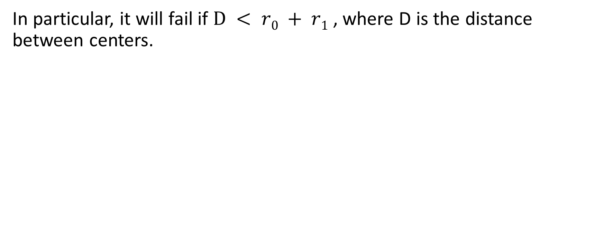
The inner tangent calculation fails when the circles are too close to each other
In particular, it will fail if $D < r0 + r1$, where D is the distance between centers.
%% FAIL CASE example -
% find the points for two circles, unequal radii, inner, circles too
% close together (criteria is that r1+r2 <= D, where D is distance
% between centers)
fig_num = 92;
centers_start = [1 1];
centers_end = [3 1];
radii_start = [1];
radii_end = [1.1];
cross_products_start = [1];
cross_products_end = [-1];
[...
points_tangent_start, ...
points_tangent_end] ...
= ...
fcn_geometry_findTangentPointTwoCircles(...
centers_start,...
centers_end,...
radii_start,...
radii_end,...
cross_products_start,...
cross_products_end,...
fig_num)

Slide 66
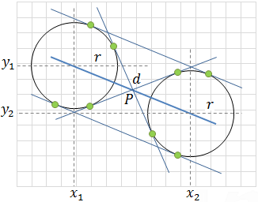
If the circles have the same radii, then the angle between the centers of the circles is used to calculate the outer tangent points for both circles
Positive cross product
Negative cross product
x_{1,2} = x₁ ± r sinθ | y_{1,2} = y₁ ∓ r cosθ
x_{3,4} = x₂ ± r sinθ | y_{3,4} = y₂ ∓ r cosθ
See: script_test_fcn_geometry_findTangentPointTwoCircles.m

Slide 67
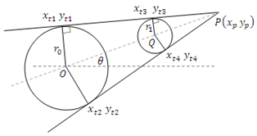
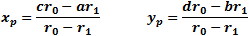
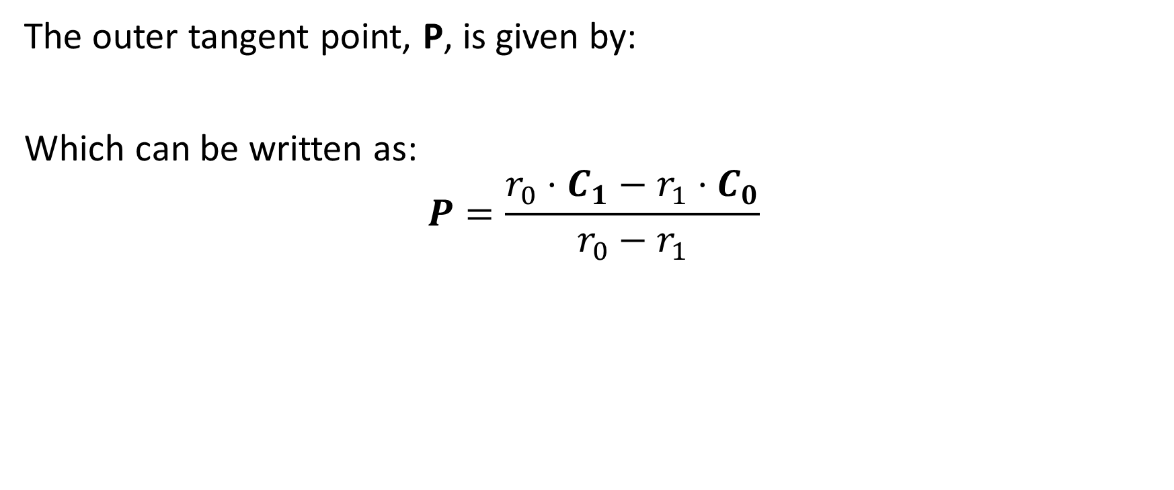
When circles have different radii, an external point is calculated
The outer tangent point, P, is given by:
Which can be written as:
$$P=\frac{r_{0}⋅C_{1}−r_{1}⋅C_{0}}{r_{0}−r_{1}}$$

Slide 68
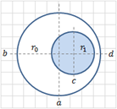
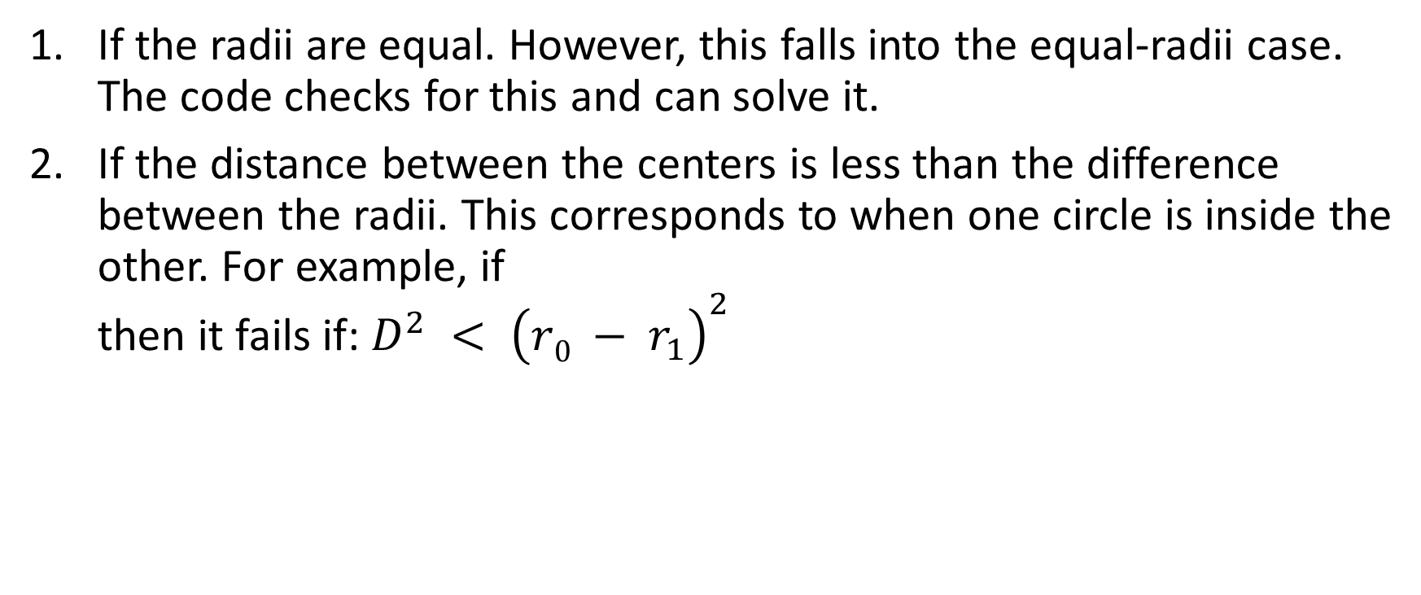
There are two conditions where the calculation of outer tangents can fail
If the radii are equal. However, this falls into the equal-radii case. The code checks for this and can solve it.
If the distance between the centers is less than the difference between the radii. This corresponds to when one circle is inside the other. For example, if then it fails if: $D^{2} < {\left(r0 − r_{1}\right)}^{2}$

